Slide 1

Engineering Multifaceted Features for Robust Fake News Classification
Uthkarsh Reddy Junuthula
Jashia Mitayeegiri
Mohammed Abdul Azeem
Mohammed Sabith Abul Faiz

Slide 2
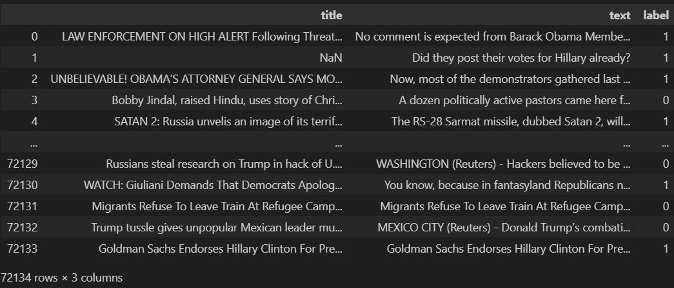
Introduction
Fake news has been prevalent for ages, but we are currently new to online fake news which is virtual and has got no bounds to it as the user is not physically present and no one can be found as the main source of it. It has got high influences on the people and has shifted the locus of interest related to the contemporary issue. The dataset we have chosen will help to detect the rumours and fake news used in the articles. This mainly helps us to gain insight into the fake news and the latent pattern involved in it which promotes us to implement a safer internet space.

Slide 3
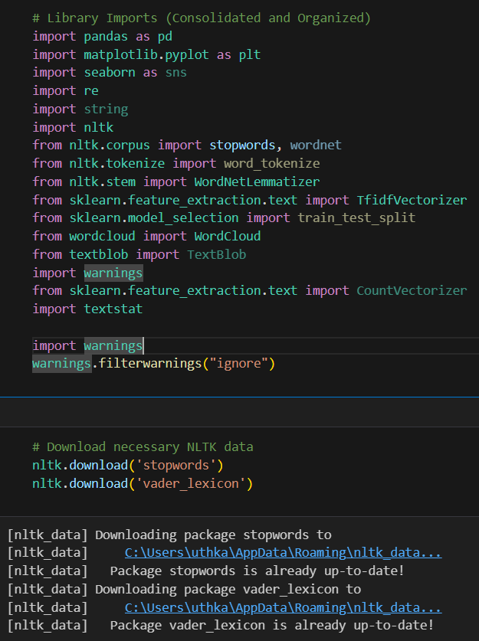
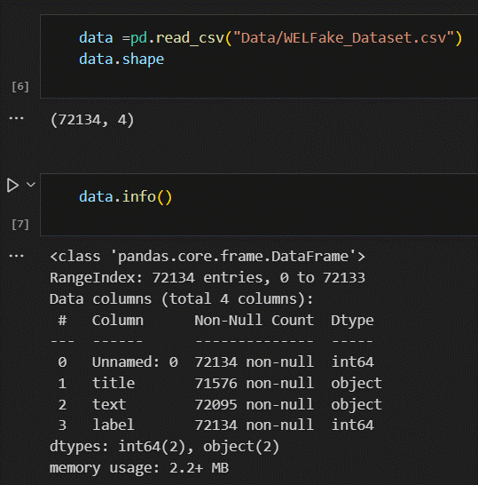
Data Import and Initial Exploration
In the initial steps we have imported essential libraries for this project such as (Pandas, Matplotlib, Seaborn, NLTK, etc.).
Downloaded the packages stopwords and vader_lexicon, for later phases of the project
Load the dataset and display its shape and basic information.
And then unnecessary columns were dropped

Slide 4
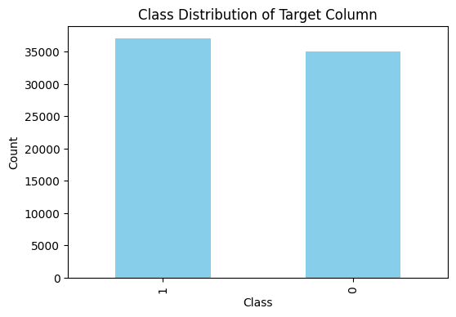
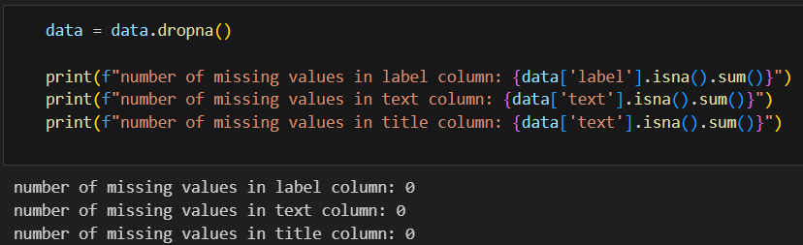

Data Cleaning and Visualization
- In this section, missing values have been dealt with in all the columns
- A bar plot has then been plotted to check the class distribution of the target column. It can be observed that both the classes are almost similar in size
- This is a good indication, as imbalanced classes can lead to poor model performance, especially for the minority class. The model will be biased towards predicting the majority class and have high error rates on the minority class.

Slide 5
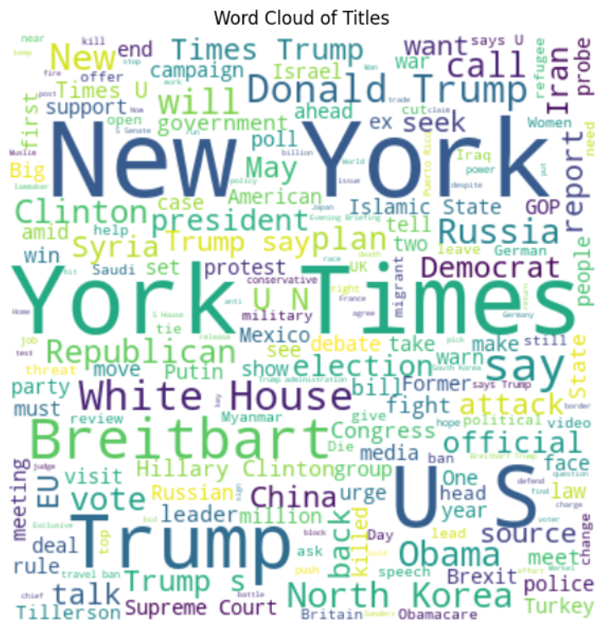
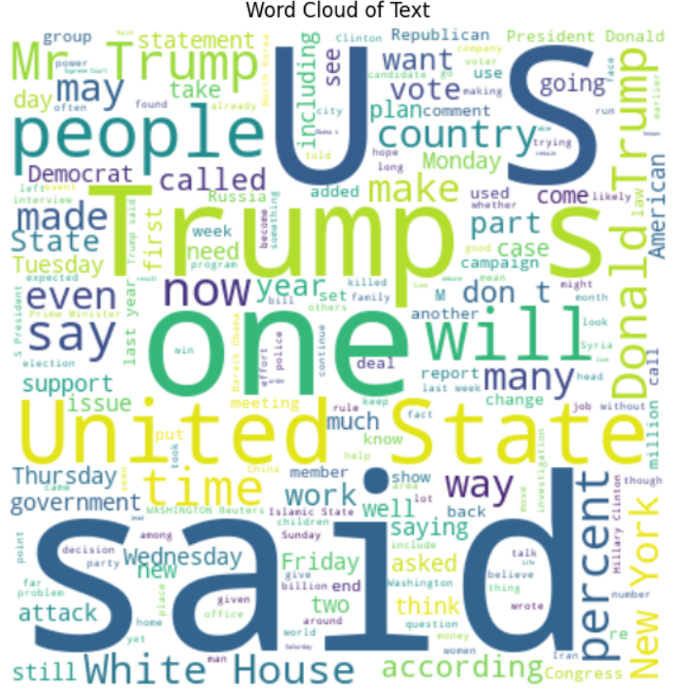
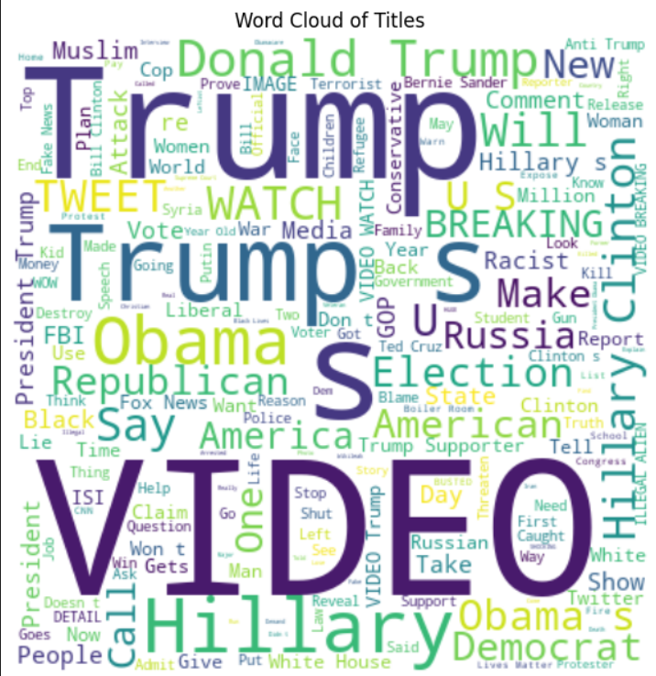
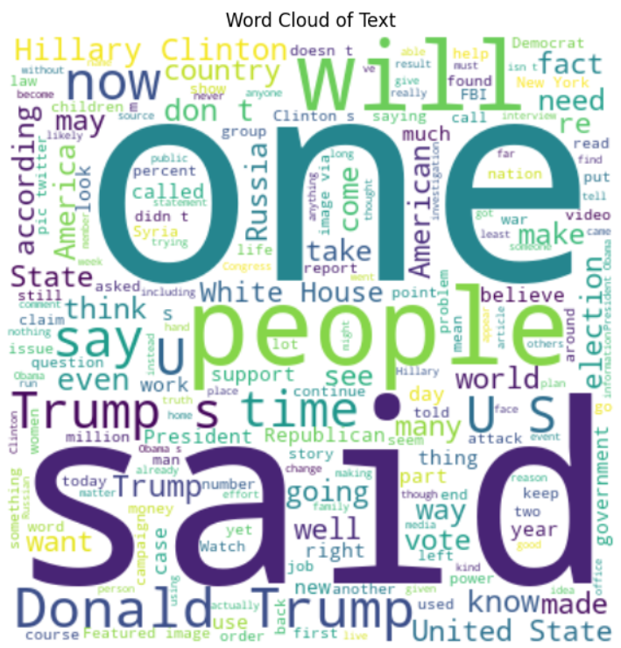
Word Cloud Generation
- Word clouds are visual representations of text data, typically used to depict keyword metadata
- In this section we have filtered the data and divided the dataset into real and fake.
- Using those, we have generated word clouds of Titles columns and text columns.
- From the output we can see that Trump was the major word used in the titles and text in both real and fake news

Slide 6
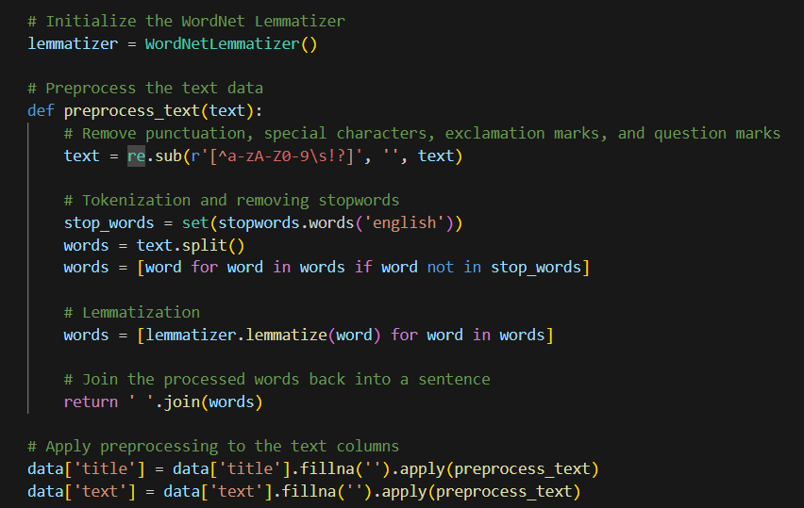
Text Preprocessing
Initializing WordNet Lemmatizer: Converts words to their root form using WordNetLemmatizer().
Removing Unwanted Characters: Cleans text by eliminating special characters and punctuation using regex (re.sub).
Tokenization and Stopword Removal: Splits text into individual words and removes common, non-meaningful words (stopwords.words('english')).
Lemmatization: Transforms words to their base form, like changing "running" to "run" using lemmatizer.lemmatize.
Applying Preprocessing to Data Columns: Processes 'title' and 'text' columns in data, handling missing values and using preprocess text function.

Slide 7
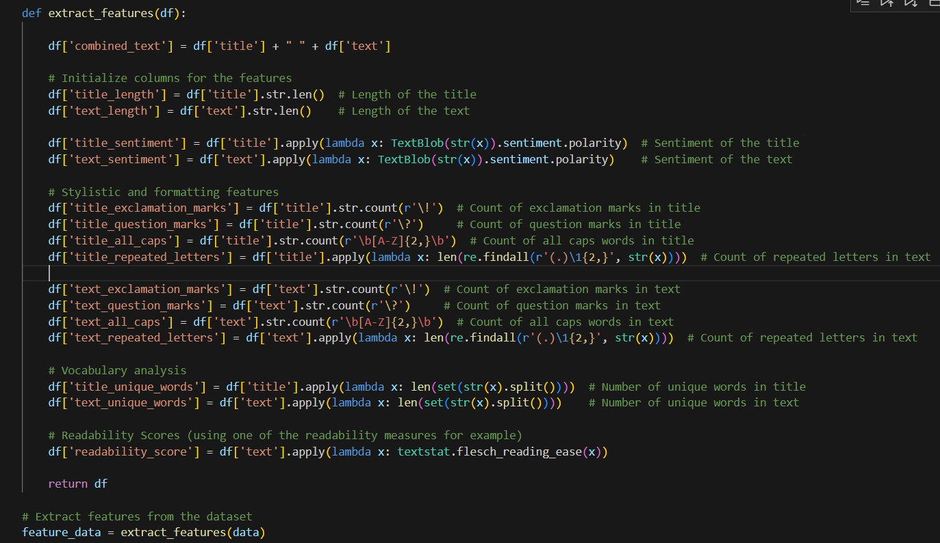
Feature Extraction
Title and Text Lengths: These indicate the article's size; longer articles may contain more information or detail, influencing their classification.
Sentiment Analysis: Analyzing the sentiment of the title and text reveals the article's tone, with certain sentiments being more common in specific news categories.
Exclamation and Question Marks: A high count of these marks can suggest an article's tone or style, such as sensationalism or inquisitiveness.
All Caps Words: Use of all caps often signals emphasis or urgency, particularly in headlines.
Repeated Letters: The presence of repeated letters can imply emotional intensity or a casual writing style.
Unique Words Count: This reflects the diversity of vocabulary used, potentially indicating the article's complexity or intended audience.
Readability Score: This metric measures how easy the text is to read and understand, with different news genres catering to varying readability levels.

Slide 8
Combining Text and Non-Text Features for Classification
Text Data Vectorization: Utilizes TfidfVectorizer with a limit of 5000 features to convert the 'combined_text' column of feature_data into a numerical format, enabling machine learning algorithms to process textual data.
Non-Text Feature Selection: Extracts other relevant features by removing text columns ('title', 'text', 'combined_text') and the target column ('label') from feature_data, focusing on numerical or categorical data for analysis.
Combining Features: Merges the vectorized text data (X_text) with the non-text features into a single DataFrame X, ensuring that all important attributes are included for model training.
Target Variable Extraction: Identifies 'label' column from feature_data as the target variable y, which is essential for supervised learning models to learn the relationship between features and the outcome.

Slide 9
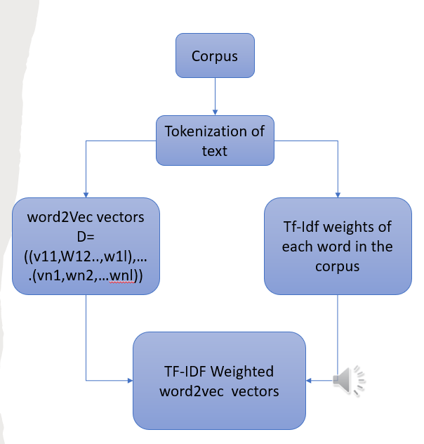
Implementation
Using the tf idf vectors along with numeric features
Using Word2vec vector along with the numeric features
Using the TF-IDF weighted Word2vec vectors
Using the TF-IDF weighted Word2vec vectors with the numeric features.
All the above features are passed through
Logistic regression model
Linear Discriminant analysis
Neural network

Slide 10
Models | TF-IDF vectors + text characteristics | Word2vec vectors + text characteristics | TF-IDF weighted Word2vec vectors | TF-IDF weighted Word2vec vectors + text characteristics
Logistic Regression | 92% | 92% | 88% | 91%
Linear Discriminant analysis | 89% | 90% | 87% | 90%
Artificial neural networks | 93.32% | 93.95% | 89.47% | 94.17%

Slide 11
References
References
Mitchell, A., Gottfried, J., Barthel, M., & Sumida, N. (2019). Distinguishing Between Factual and Opinion Statements in the News. Pew Research Center.
Silverman, C. (2016). This Analysis Shows How Viral Fake Election News Stories Outperformed Real News on Facebook. BuzzFeed News.
Rubin, V. L., Chen, Y., & Conroy, N. J. (2015). Deception detection for news: three types of fakes. Proceedings of the Association for Information Science and Technology, 52(1), 1-4.
Potthast, M., Kiesel, J., Reinartz, K., Bevendorff, J., & Stein, B. (2018). A stylometric inquiry into hyperpartisan and fake news. Proceedings of the 56th Annual Meeting of the Association for Computational Linguistics (Volume 1: Long Papers), 231-240.
Rashkin, H., Choi, E., Jang, J. Y., Volkova, S., & Choi, Y. (2017). Truth of varying shades: Analyzing language in fake news and political fact-checking. Proceedings of the 2017 Conference on Empirical Methods in Natural Language Processing, 2931-2937.
Tacchini, E., Ballarin, G., Della Vedova, M. L., Moret, S., & de Alfaro, L. (2017, August). Some like it Hoax: Automated fake news detection in social networks. In Proceedings of the Second Workshop on Data Science for Social Good (pp. 1-5).
Volkova, S., Shaffer, K., Jang, J. Y., & Hodas, N. (2017). Separating facts from fiction: Linguistic models to classify suspicious and trusted news posts on Twitter. In Proceedings of the 55th Annual Meeting of the Association for Computational Linguistics (Volume 2: Short Papers) (pp. 647-653).
Wang, Y., Ma, F., Jin, Z., Yuan, Y., Xun, G., Jha, K., Su, L., & Gao, J. (2018). Eann: Event adversarial neural networks for multi-modal fake news detection. In Proceedings of the 24th acm sigkdd international conference on knowledge discovery & data mining (pp. 849-857).
Zhou, X., Jain, A., Phoha, V. V., & Zafarani, R. (2020). Fake news early detection: A theory-driven model. Digital Threats: Research and Practice, 1(2), 1-25.
Shu, K., Mahudeswaran, D., Wang, S., Lee, D., & Liu, H. (2020). FakeNewsNet: A Data Repository with News Content, Social Context, and Spatiotemporal Information for Studying Fake News on Social Media. Big Data, 8(3), 171-188.

